Slide 1
Introduction to Data Science
DSGT
9/9/19
http://bit.ly/2lGfais ; 147692

Slide 2
Before we get into what Data Science is….
Notes:
Ask them to provide a real life example

Slide 3
LET’S TALK ABOUT WHAT IT’S NOT
Common misnomers about Data Science

Slide 4


IT IS NOT PRESENTING FANCY CHARTS IN EXCEL
What do I gain from these charts? What’re they telling me?

Slide 5

IT IS NOT JUST MACHINE LEARNING
Okay, you wanna use k-Means Clustering. Why? What’s the purpose?
What am I going to gain from it?

Slide 6
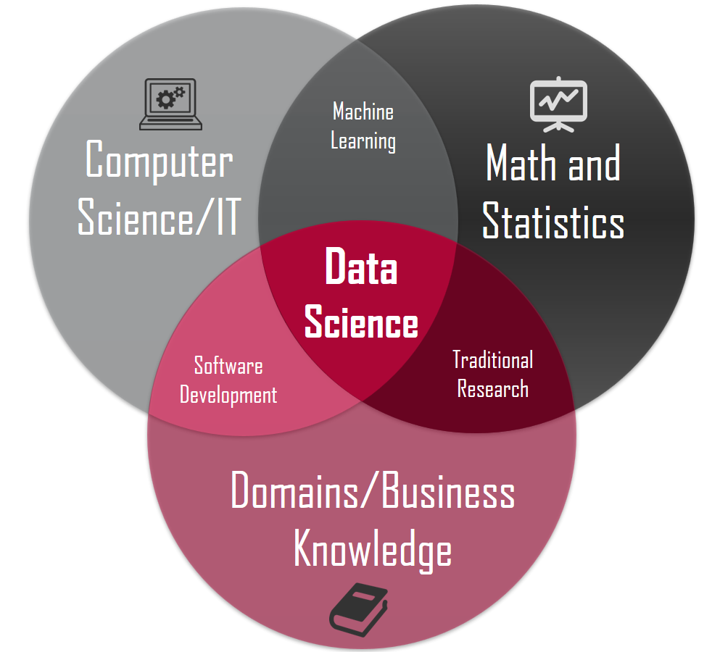
UGH, TELL ME WHAT IT IS!
“An interdisciplinary field about scientific methods, processes, and systems to extract knowledge or insights from data.”

Slide 7
HAVE YOU NOTICED ANY APPLICATIONS OF DATA SCIENCE AROUND YOU?

Slide 8

UNDERSTANDING THE PAST
MEANINGFUL visualizations to explain what we have so far.
Emphasis on becoming one with the data.

Slide 9

PREPARING FOR THE PRESENT
EFFECTIVE transformation of the data.
Emphasis on making raw data suitable for the algorithms.

Slide 10

PREDICTING THE FUTURE
Using a wide variety of algorithms to produce some “educated guesses”.
Emphasis on comparing model performance and understanding why one is better than the other.

Slide 11
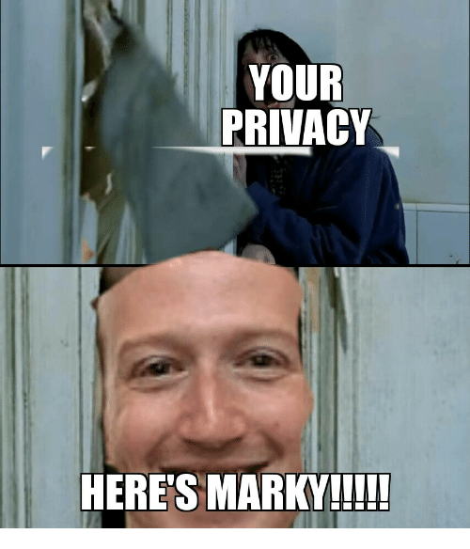
ETHICAL CONSIDERATIONS
Naturally rises due to the value of the data we collect.
Must ensure steps are taken to maintain privacy while using data.

Slide 12
ANY QUESTIONS?

